Slide 1
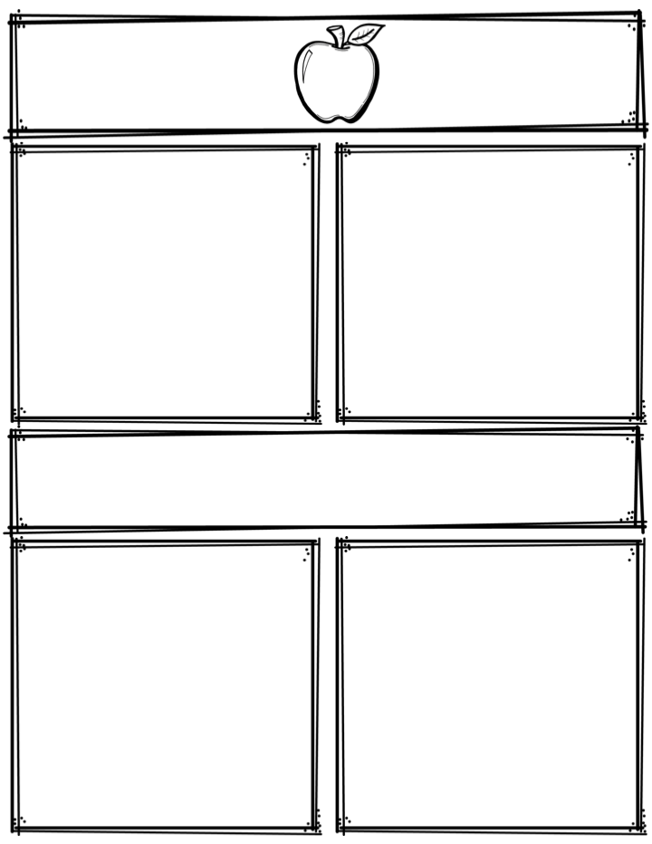
Weekly News
Mrs. Necessary
9/25/17-9/29/17
Spelling Words
Upcoming Events
can’t
shall
those
both
paper
pushed
sharp
shock
crash
showed
shoes
shoulder
product
quotient
multiplication
Friday 9/29– Sock-hop 6-7:30pm
(If attending, please return form
sent home last week.)
3rd Grade
Contact: mnecessary@phill69.com or (309)637-6829
What we are learning
Reminders
Math- Solving word problems using 3 digit addition/subtraction.
Language Arts- Identifying key ideas and details. Understanding text structure and narrative elements.
Science- Plants
Social Studies- Mexico
**Please sign and return your child’s progress report if you haven’t already done so.
**Spelling and math tests every Friday
**I will send home graded spelling and math tests every Monday along with the weekly news.
**Read at least 10 minutes every day

Slide 2
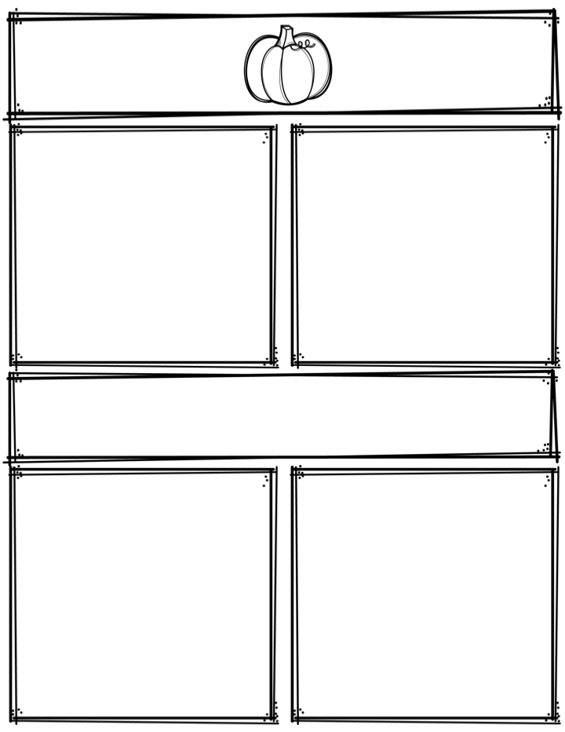
Weekly News
Cherry Park
Mrs. Martinez
Kindergarten
Type Title Here
Type Title Here
Type text here.
Type text here.
Type Title Here
Type text here.
Type text here.
Type text here.
Type text here.
Type text here.
Type Title Here
Type Title Here
Type text here.
Type text here.

Slide 3
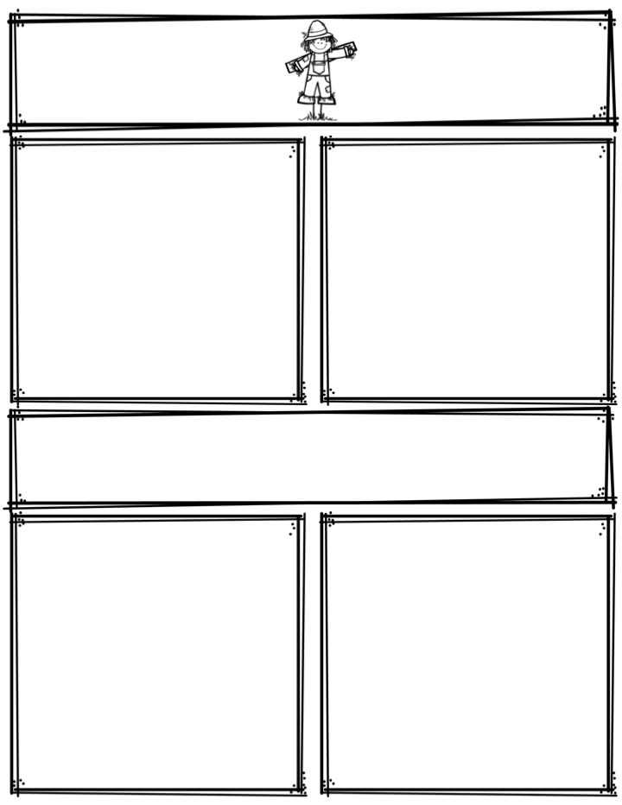
Weekly News
Cherry Park
Mrs. Martinez
Kindergarten
Type Title Here
Type Title Here
Type text here.
Type text here.
Type Title Here
Type text here.
Type text here.
Type text here.
Type text here.
Type text here.
Type Title Here
Type Title Here
Type text here.
Type text here.

Slide 4
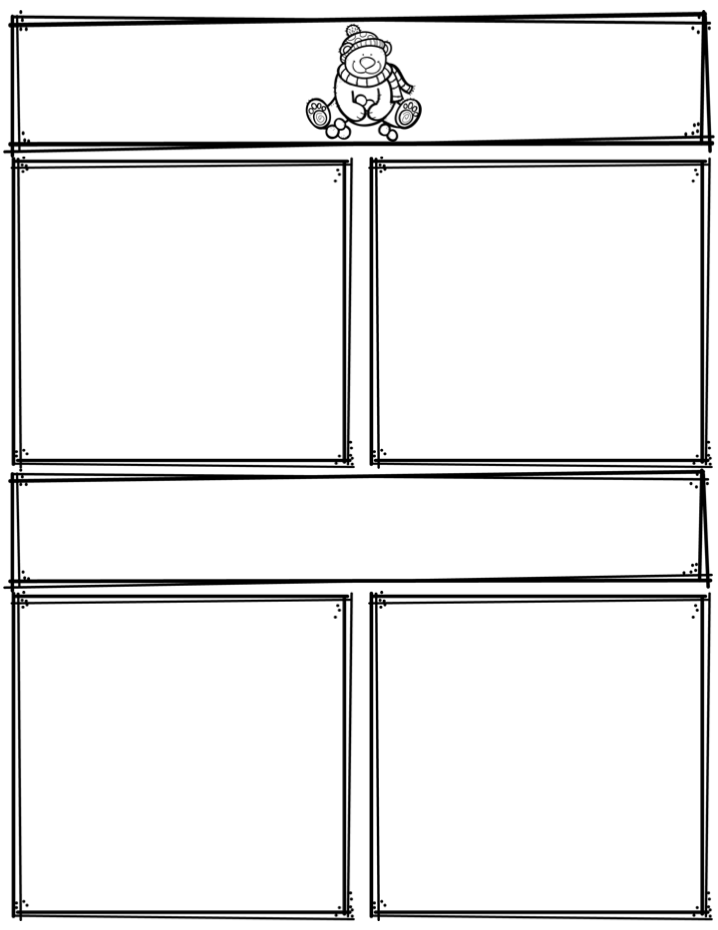
Weekly News
Cherry Park
Mrs. Martinez
Kindergarten
Type Title Here
Type Title Here
Type text here.
Type text here.
Type Title Here
Type text here.
Type text here.
Type text here.
Type text here.
Type text here.
Type Title Here
Type Title Here
Type text here.
Type text here.

Slide 5
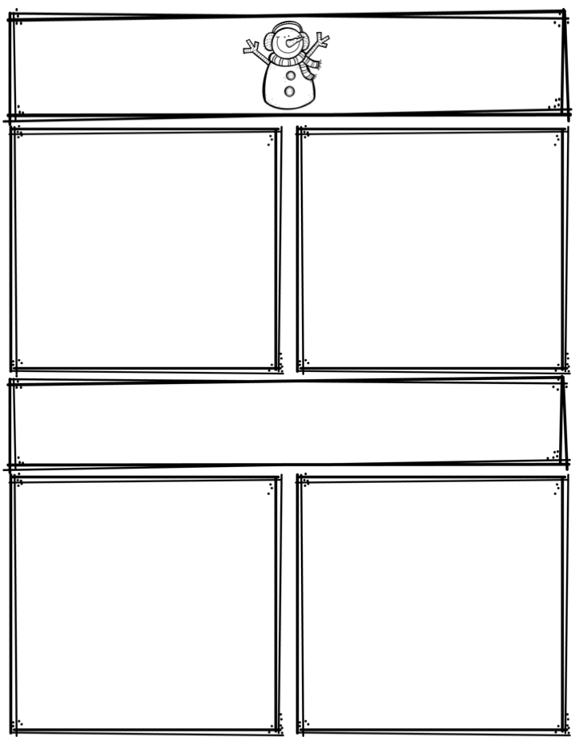
Weekly News
Cherry Park
Mrs. Martinez
Kindergarten
Type Title Here
Type Title Here
Type text here.
Type text here.
Type Title Here
Type text here.
Type text here.
Type text here.
Type text here.
Type text here.
Type Title Here
Type Title Here
Type text here.
Type text here.

Slide 6
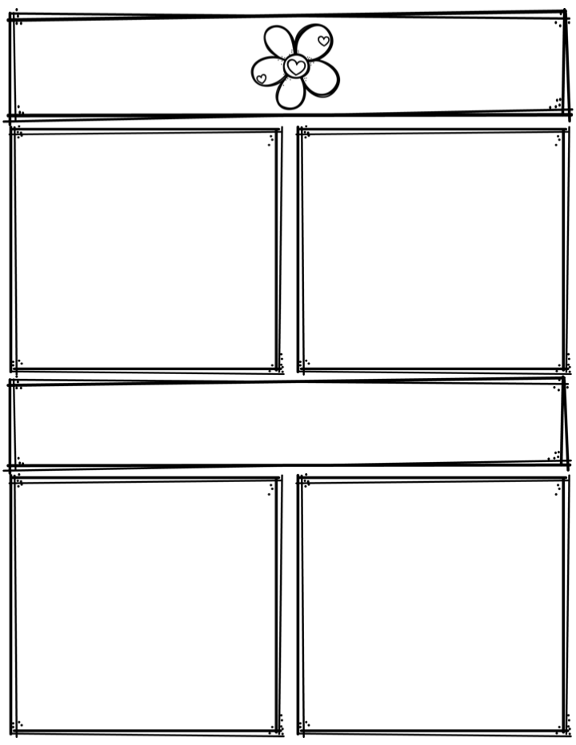
Weekly News
Cherry Park
Mrs. Martinez
Kindergarten
Type Title Here
Type Title Here
Type text here.
Type text here.
Type Title Here
Type text here.
Type text here.
Type text here.
Type text here.
Type text here.
Type Title Here
Type Title Here
Type text here.
Type text here.

Slide 7
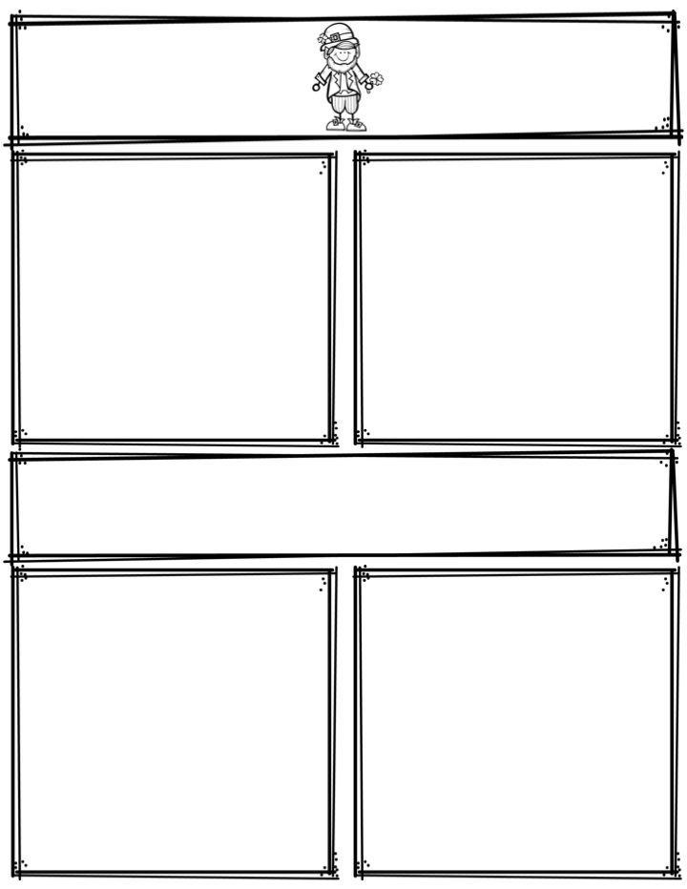
Weekly News
Cherry Park
Mrs. Martinez
Kindergarten
Type Title Here
Type Title Here
Type text here.
Type text here.
Type Title Here
Type text here.
Type text here.
Type text here.
Type text here.
Type text here.
Type Title Here
Type Title Here
Type text here.
Type text here.

Slide 8
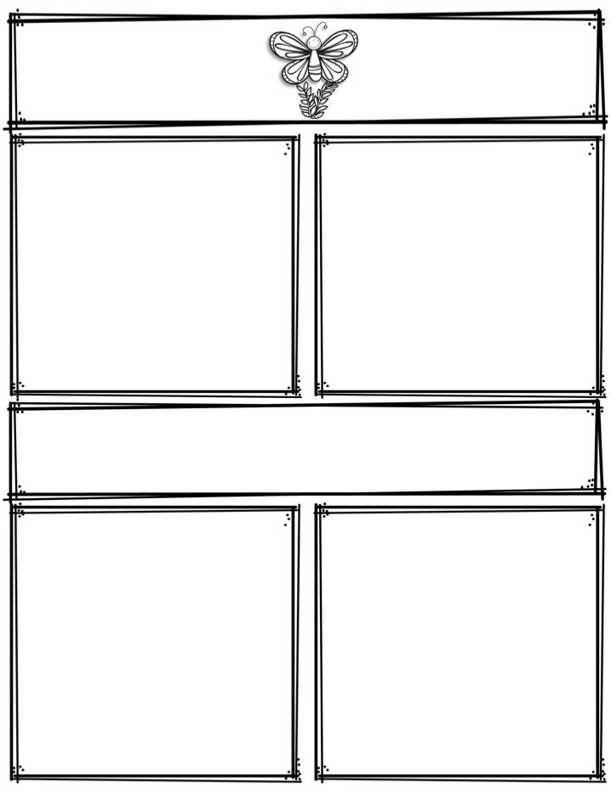
Weekly News
Cherry Park
Mrs. Martinez
Kindergarten
Type Title Here
Type Title Here
Type text here.
Type text here.
Type Title Here
Type text here.
Type text here.
Type text here.
Type text here.
Type text here.
Type Title Here
Type Title Here
Type text here.
Type text here.

Slide 9
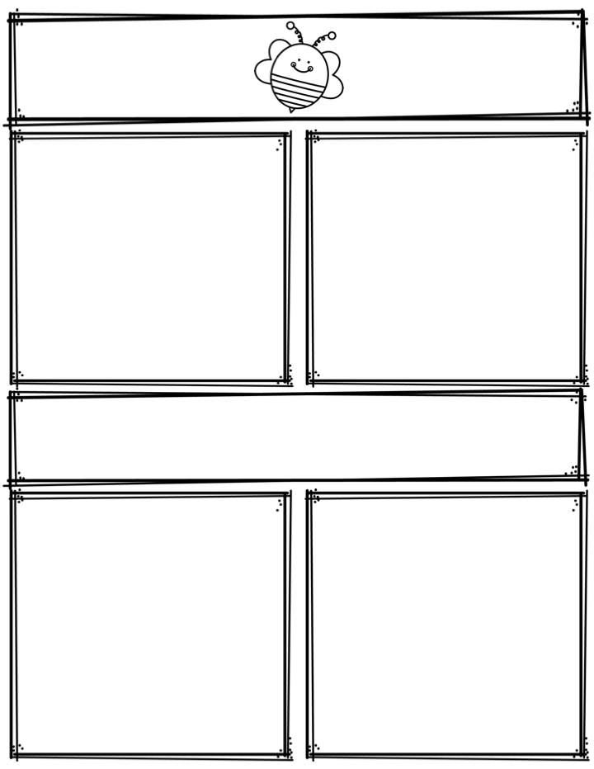
Weekly News
Cherry Park
Mrs. Martinez
Kindergarten
Type Title Here
Type Title Here
Type text here.
Type text here.
Type Title Here
Type text here.
Type text here.
Type text here.
Type text here.
Type text here.
Type Title Here
Type Title Here
Type text here.
Type text here.

Slide 10
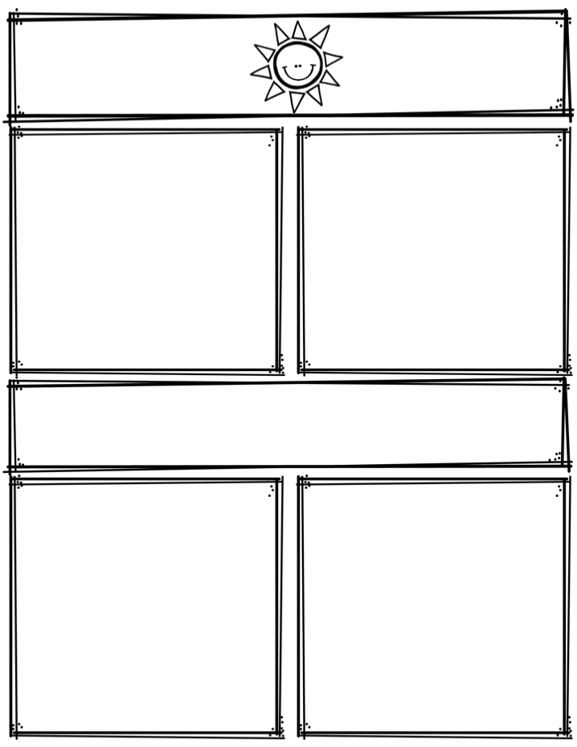
Weekly News
Cherry Park
Mrs. Martinez
Kindergarten
Type Title Here
Type Title Here
Type text here.
Type text here.
Type Title Here
Type text here.
Type text here.
Type text here.
Type text here.
Type text here.
Type Title Here
Type Title Here
Type text here.
Type text here.

Slide 11
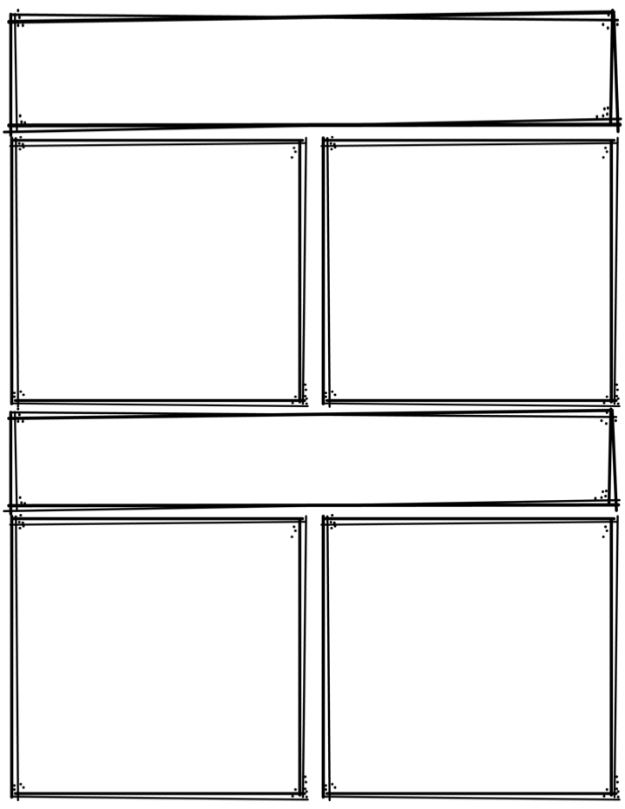
Weekly News
DELETE: Drag and drop image here
Cherry Park
Mrs. Martinez
Kindergarten
Type Title Here
Type Title Here
Type text here.
Type text here.
Type Title Here
Type text here.
Type text here.
Type text here.
Type text here.
Type text here.
Type Title Here
Type Title Here
Type text here.
Type text here.

