Slide 1
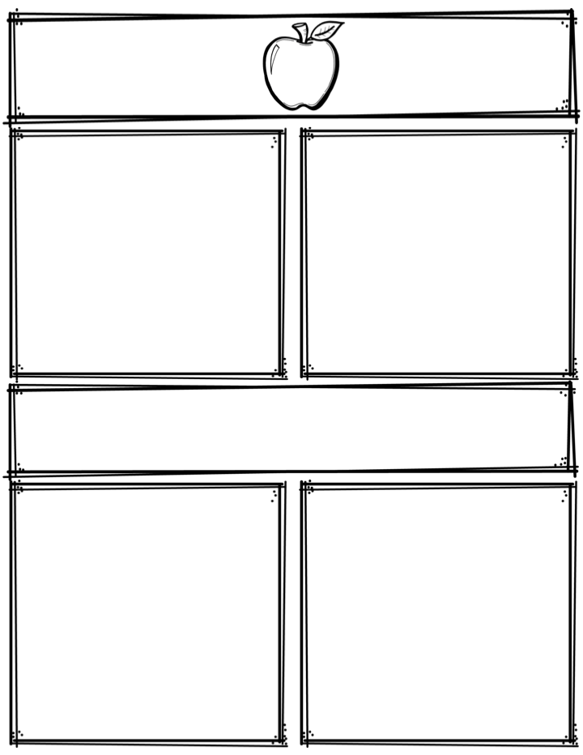
Weekly News
Mrs. Necessary
11/6/17-11/10/17
Spelling Words
Upcoming Events
south
sir
without
second
birds
loose
choose
shook
understood
balloon
looked
moose
wheel
season
axle
11/3/17 -11/10/17 – Canned food drive
11/10/17 – Pizza Friday $2 per slice, order forms
due by Thursday 11/9/17
11/22/17-11/24/17 – NO SCHOOL
11/29/17 – Progress reports
12/1/17 – POPCORN FRIDAY! 25 cents per bag, up
to 4 bags
Everyday in November – Friend grams $2 each, delivered
every Friday to friends
3rd Grade
Contact: mnecessary@phill69.com or (309)637-6829
What we are learning
Reminders
Math- Multiplication fluency
Language Arts- Homonyms/Synonyms/Antonyms
Science- Animals/Selection Process
Social Studies- U.S. states
**Read 10 minutes every night
**Study spelling words

