Slide 1
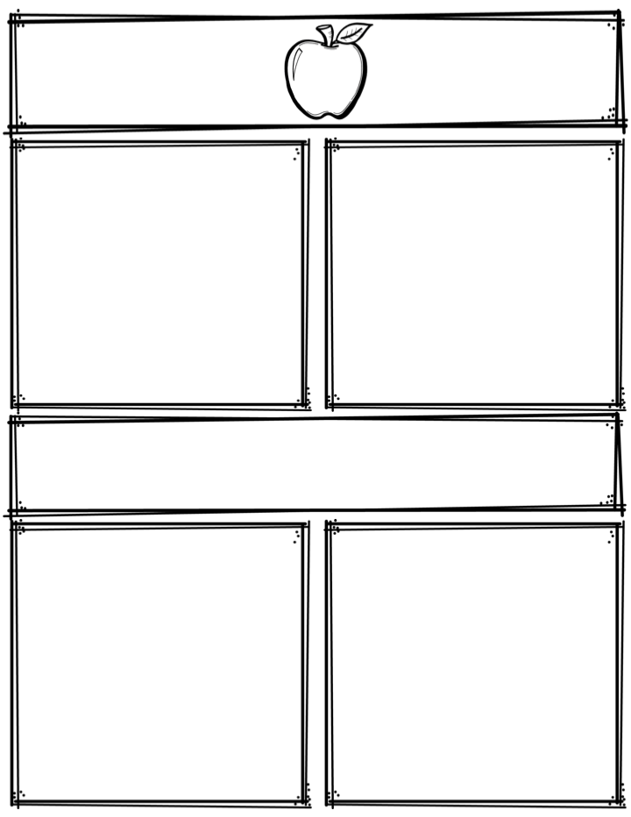
Weekly News
Mrs. Necessary
11/27/17-12/1/17
Spelling Words
Upcoming Events
sleep
carry
north
once
book
crawl
laundry
author
taught
pause
dawn
folklore
custom
disappear
willow
11/28/17 – Book orders due
11/29/17 – Progress reports
12/1/17 – POPCORN FRIDAY! 25 cents per bag, up
to 4 bags
Everyday in November – Friend grams $2 each, delivered
every Friday to friends
3rd Grade
Contact: mnecessary@phill69.com or (309)637-6829
What we are learning
Homework
Math- Intro to division
Language Arts- Concept words/Plurals
Science- Bridge design/Forces
Social Studies- Illinois/U.S. States
**Read 10 minutes every night
**Study spelling words every night

