Slide 1
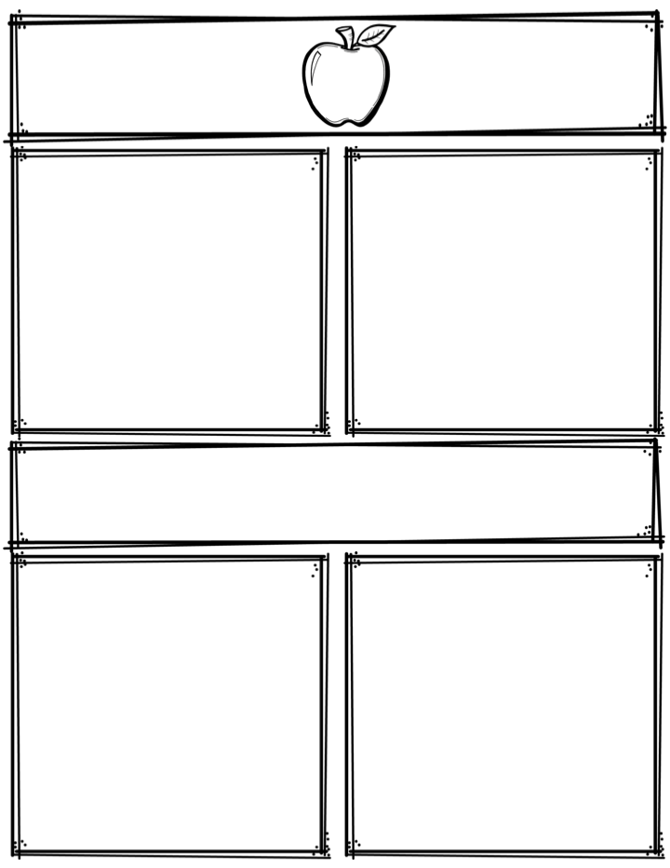
Weekly News
Mrs. Necessary
11/20/17-11/21/17
Spelling Words
Upcoming Events
11/20/17 – Superhero day –dress as a superhero
11/21/17 – Role swap day – dress as a teacher
11/22/17-11/24/17 – NO SCHOOL
11/28/17 – Book order forms due
11/29/17 – Progress reports
12/1/17 – POPCORN FRIDAY! 25 cents per bag, up
to 4 bags
Everyday in November – Friend grams $2 each, delivered
every Friday to friends
3rd Grade
Contact: mnecessary@phill69.com or (309)637-6829
What we are learning
Reminders
Math- Multiplication review
Language Arts- Skills review
Science- None
Social Studies- History of Thanksgiving
**Read 10 minutes every night
**Study spelling words every night
HAVE A NICE THANKSGIVING BREAK!

