Slide 1
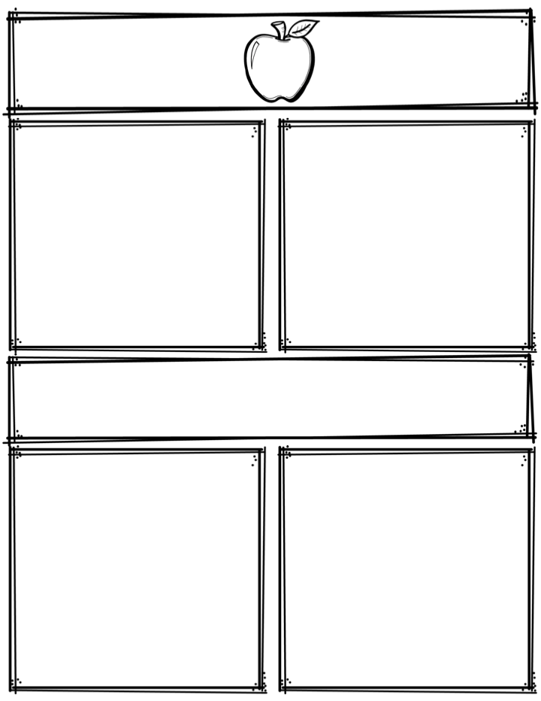
Weekly News
Mrs. Necessary
11/13/17-11/17/17
Spelling Words
Upcoming Events
among
buy
fairy
real
almost
stairs
glare
airplane
airy
repair
prepare
culture
delta
bayou
interact
11/3/17 -11/17/17 – Canned food drive
11/15/17 – Spirit wear order forms due
11/20/17 – Superhero day –dress as a superhero
11/21/17 – Role swap day – dress as a teacher
11/22/17-11/24/17 – NO SCHOOL
11/28/17 – Book order forms due
11/29/17 – Progress reports
12/1/17 – POPCORN FRIDAY! 25 cents per bag, up
to 4 bags
Everyday in November – Friend grams $2 each, delivered
every Friday to friends
3rd Grade
Contact: mnecessary@phill69.com or (309)637-6829
What we are learning
Reminders
Math- Multiplication fluency and arrays
Language Arts- Context clues
Science- Forces/weights and pulleys
Social Studies- U.S. states
**Read 10 minutes every night
**Study spelling words every night

