Slide 1
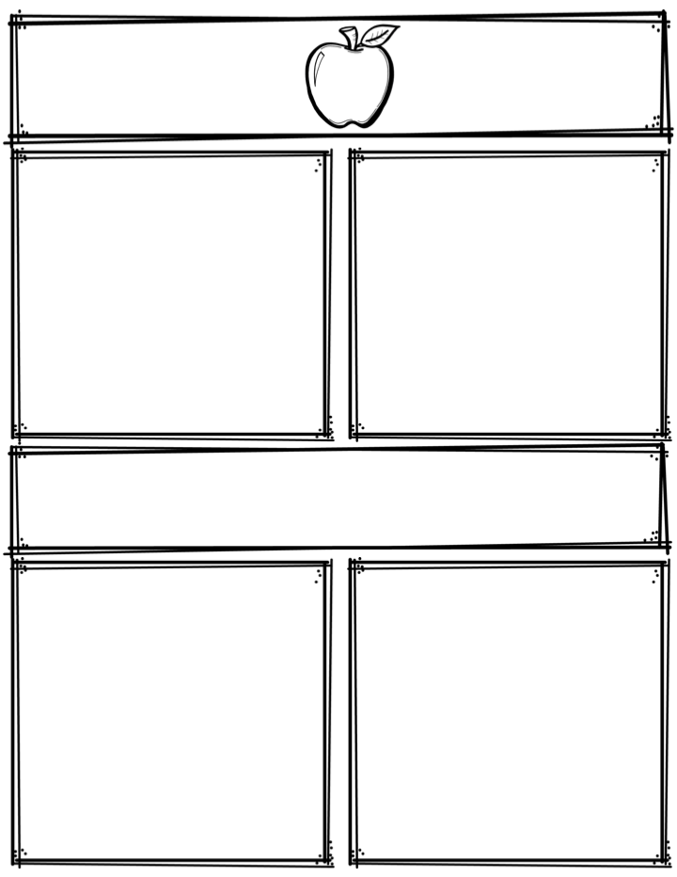
Weekly News
Mrs. Necessary
10/23/17-10/26/17
Spelling Words
Upcoming Events
held
cross
night
walk
picked
choice
voice
royal
annoy
noise
tomato
potato
citrus
nutrients
vitamins
10/25/17 & 10/26/17– Student
led parent teacher conferences
4-7pm (Visit the book fair!)
10/27/17– NO SCHOOL
10/31/17 – K-4th Halloween parade 9am
- Early dismissal 11:30am
3rd Grade
Contact: mnecessary@phill69.com or (309)637-6829
What we are learning
Reminders
Math- Multi-step word problems
Language Arts- Sequencing, key ideas and details
Science- Animals
Social Studies- Regions of the U.S.
**Read 10 minutes every night
**Study spelling words

