Slide 1
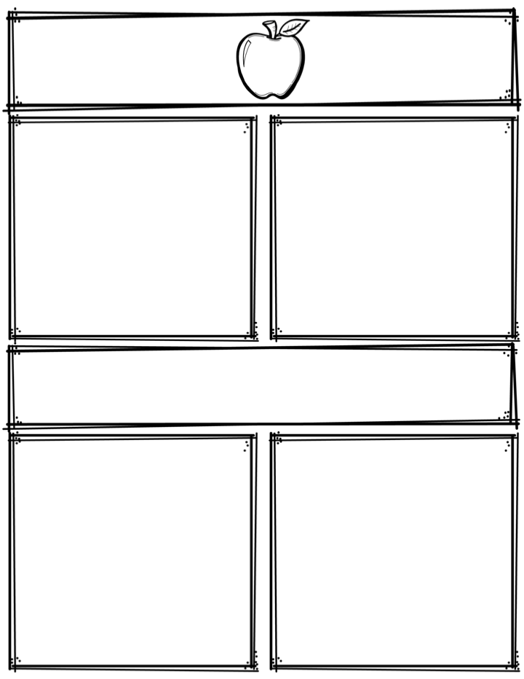
Weekly News
Mrs. Necessary
10/2/17-10/6/17
Spelling Words
Upcoming Events
cloud
child
open
example
begin
chance
match
watch
batch
steel
speech
source
material
ditch
women
Monday, October 9th – NO SCHOOL
3rd Grade
Contact: mnecessary@phill69.com or (309)637-6829
What we are learning
Reminders
Math- Intro to multiplication
Language Arts- Paragraph writing
Science- animals/habitats/fossils
Social Studies- Mexico
**Please sign and return your child’s progress report if you haven’t already done so.
**Please remember to return your child’s behavior log and blue folder to school each day.
**Read at least 10 minutes every day

