Slide 1
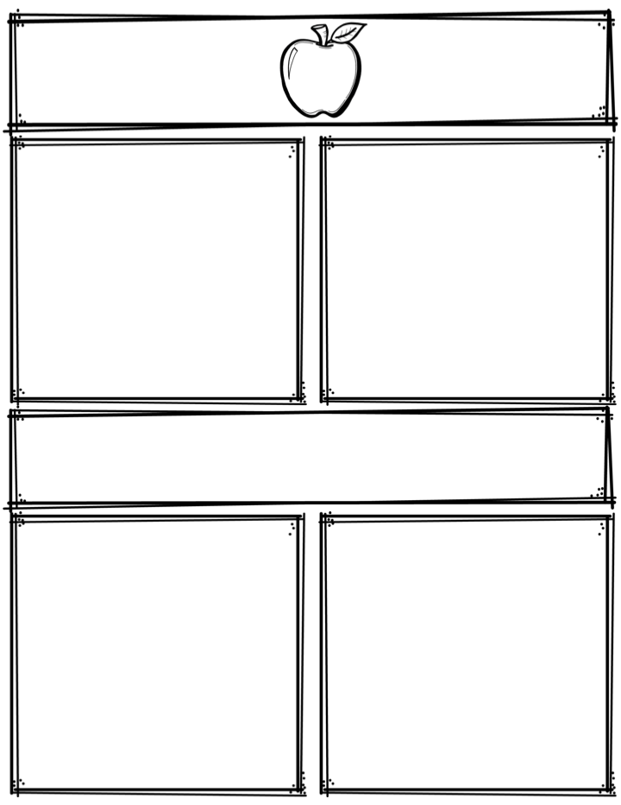
Weekly News
Mrs. Necessary
10/10/17-10/13/17
Spelling Words
Upcoming Events
together
tied
group
often
table
space
fence
price
office
police
pencil
civil
tribal
buffalo
dance
10/18/17– Hispanic Heritage
Celebration 1-2:30pm, all families
welcome
10/25/17 & 10/26/17– Student
led parent teacher conferences
4-7pm
10/27/17– NO SCHOOL
3rd Grade
Contact: mnecessary@phill69.com or (309)637-6829
What we are learning
Reminders
Math- Multiplication
Language Arts- Compare/Contrast, key ideas and details
Science- Fossils/Dinosaurs
Social Studies- Mexico
**Sign up online for student led conferences using the link sent out through text or type link below in the search bar.
http://www.signupgenius.com/go/508054baaa823a3fd0-student
**Read 10 minutes every night

